Slide 1
Self Driving Car Technology Predicting Steering Angles
Notes:
In this section we are going to look at some of the computer vision and AI technology used in self driving cars, specifically an approach to predict the steering angle based on a feed of images of the road ahead.

Slide 2
THIS CODE IS NOT DESIGNED FOR REAL LIFE USAGE!
Notes:
So let’s start with a very important caveat, this code is not designed to run on a real car. There are a large number of safety features that a real autonomous vehicle has that we won’t cover here. However, section is designed to introduce you to an approach to do this, and can help you get started on a career in this space if you so wish!

Slide 3
What we will cover in this section
IMPORTANT REMINDER!!
How can we predict steering angles for a car
What are convolutional neural networks (CNNs)
Environment and dataset
Exploring our data
Training our model
Testing our model
Notes:
This slide, like mentioned above is for multiple pointers. The information above covers the types of information that can be used in this slide
https://aws.amazon.com/blogs/machine-learning/build-your-own-face-recognition-service-using-amazon-rekognition/

Slide 4
4.1 Intro to CNNs
Notes:
In this section we are going to look at some of the computer vision and AI technology used in self driving cars, specifically an approach to predict the steering angle based on a feed of images of the road ahead.

Slide 5
THIS CODE IS NOT DESIGNED FOR REAL LIFE USAGE!
Notes:
So let’s start with a very important caveat, this code is not designed to run on a real car. There are a large number of safety features that a real autonomous vehicle has that we won’t cover here. However, section is designed to introduce you to an approach to do this, and can help you get started on a career in this space if you so wish!

Slide 6
How can we predict the steering angle of a car?
Notes:
Rekognition relies on a combination of AWS capabilities to work.
Rekognition provides the ability to detect objects in images, and for our purposes we’ll be using it to recognize faces from a training set.
Lambda is Amazon Web Services’ serverless computing capability. This means we can simply define the code we want to run, and when it runs (for example when we provide an image) without us having to worry about deploying or configuring a server
DynamoDB is a NoSQL database, we’ll use it to store results of faces in images
S3 is a filestore, this is where we’ll upload our images ready for our Lambda service to act on them

Slide 7
What are Convolutional Neural Networks (CNNs)
CNNs are…
Notes:
Before we start, we need to set up our account in AWS. There are really good guides for this available on the AWS website, so I’ve provided links here rather than showing you how to do this. Once you’ve created your AWS account, an IAM user and added the managed policies listed above to your IAM user, make sure you download the CSV containing your key pair before continuing. We’ll need that in the next step.

Slide 8
4.2 Environment and Data
Notes:
In this section we are going to look at some of the computer vision and AI technology used in self driving cars, specifically an approach to predict the steering angle based on a feed of images of the road ahead.

Slide 9
What we will cover
Environment
Where to get the dataset
Size of the dataset
Viewing the datasets steering angles
What observations can be made?

Slide 10
Environment
This model requires a powerful PC, preferably with a GPU, or use of a cloud GPU instance
It took many hours to train to a level where the predicted angles were accurate enough for demo purposes
Please check Python version compatibility with Tensorflow!
Notes:
Expected to take about a few days to train on a decent spec Macbook Pro
Took approx. 5 hours on a 2core 13GB VM in Google cloud using a Nvidia K80 GPU
However, I’ve provided a pre-trained model so you can still work with the code and understand what it is doing
Note that at this point in time, Tensorflow wasn’t compatible with Python 3.7. I used Python 3.6 and TF 1.11 here!

Slide 11
Dataset
The dataset is available here:
You can download it with the following script:
Notes:
As you can see, a large percentage of the dataset has a steering angle of between -5 and +5 degrees. This can potentially cause training issues where the algorithm may get 70% accuracy by just returning 0 as the answer! Obviously this won’t be a good thing in a real car!!

Slide 12
Let’s explore the dataset…
Notes:
As you can see, a large percentage of the dataset has a steering angle of between -5 and +5 degrees. This can potentially cause training issues where the algorithm may get 70% accuracy by just returning 0 as the answer! Obviously this won’t be a good thing in a real car!!

Slide 13
4.3 Training Our Model
Notes:
In this section we are going to look at some of the computer vision and AI technology used in self driving cars, specifically an approach to predict the steering angle based on a feed of images of the road ahead.

Slide 14
Training our model
Creating training, validation and test datasets
Keras CNN definition
Loss functions
Debugging hints and tips
Analysing training performance
Notes:
This slide, like mentioned above is for multiple pointers. The information above covers the types of information that can be used in this slide

Slide 15
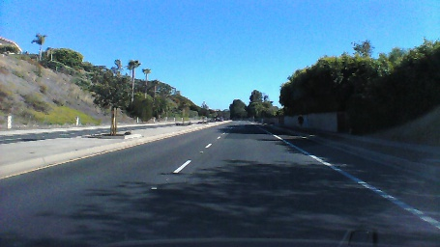
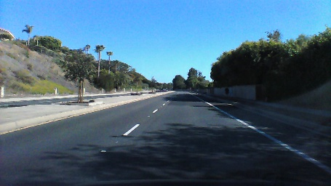
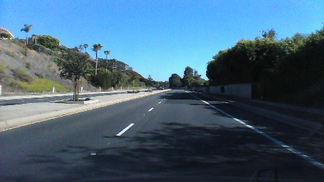
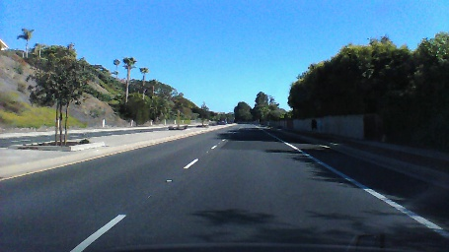
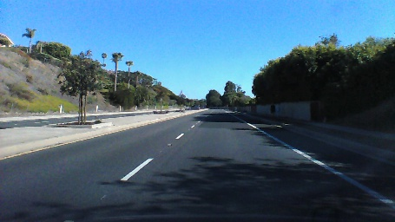
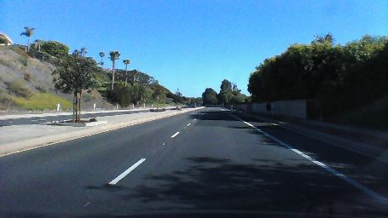
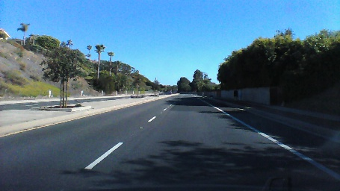
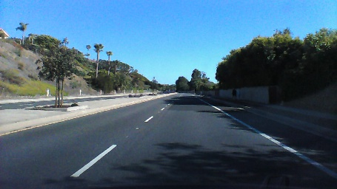
Splitting our data into train, validate and test datasets
Data set | Frames
Training | 0, 2, 4, 6, 8, 10, 12, …
Validation | 1, 5, 9, …
Test | 3, 7, 11, …
Notes:
We split the data into training, validation and testing to help train the model and understand how it predicts previously unseen examples.
During a typical training exercise, training data is used to train the model, then validation data is used to understand how well it predicts after that epoch. For example, if I train on 128 images, I would then validate how accurate the prediction was on another 128 samples.
Once the model is fully trained, you would test it on the final 20% to see how accurate it is.
This is one option of splitting the data, another way could be to take the first 60% as training data, the next 20% as validation, and the final 20% as test data.

Slide 16
Pre-processing the image
We resize and crop the image, focusing on the road as this is the region of interest for predicting steering angles.
Resizing reduces the amount of processing for each image

Slide 17
Generators
As our dataset is large, we don’t want to load it all into memory
Generators give us the ability to iterate through our dataset and train on batches
Notes:
This slide, like mentioned above is for multiple pointers. The information above covers the types of information that can be used in this slide

Slide 18
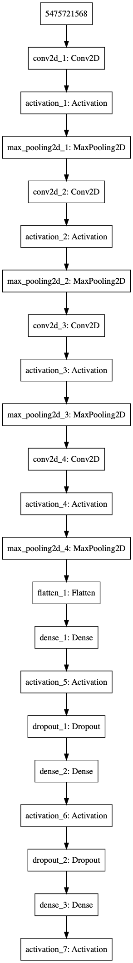
Our CNN
Angle
Notes:
Our CNN is built up of a 5 convolutional layers followed by 3 fully connected layers. Dropout is used to improve training performance by effectively dropping connections between artificial neurons. It makes those that remain more resilient to the underlying data.

Slide 19
Let’s explore the code…
Notes:
As you can see, a large percentage of the dataset has a steering angle of between -5 and +5 degrees. This can potentially cause training issues where the algorithm may get 70% accuracy by just returning 0 as the answer! Obviously this won’t be a good thing in a real car!!

Slide 20
Debugging Neural Networks
Training neural networks can be more trial-and-error than science
Prove the code works by running a small number of samples and a single batch
Train using a small number of samples to check that the model converges and you see overfitting
Increase the number of samples over time
Make changes to the network architecture, hyper-parameters, etc. to find an optimal solution
Then scale to the full dataset
See https://keras.io/getting-started/faq/#why-is-the-training-loss-much-higher-than-the-testing-loss
Notes:
This is the approach I use for training neural networks. Typically I would perform the initial training and tuning locally to ensure the code is working and the model is starting to converge or a small number samples before moving to a cloud based server to train on the full dataset.
Also, Keras disables drop-out on validation so you will notice that the validation loss is often lower than the training loss. This is OK if you have dropout in the network, but if you don’t and you see this, then you have issues relating to your data (for example you need to think about the split between train and validation more, such as validation may be skewed to a smaller set of examples than the training data)

Slide 21
Analysing Training Performance
We are looking for the [training] loss and validation loss to decrease over time

Slide 22
4.4 Inferring Steering Angles
Notes:
In this section we are going to look at some of the computer vision and AI technology used in self driving cars, specifically an approach to predict the steering angle based on a feed of images of the road ahead.

Slide 23
Testing Our Model
Testing model accuracy
Displaying the steering wheel
Smoothing out the movement
Creating a video of this in action
Notes:
This slide, like mentioned above is for multiple pointers. The information above covers the types of information that can be used in this slide

Slide 24
Let’s explore the code…
Notes:
As you can see, a large percentage of the dataset has a steering angle of between -5 and +5 degrees. This can potentially cause training issues where the algorithm may get 70% accuracy by just returning 0 as the answer! Obviously this won’t be a good thing in a real car!!

Slide 25
How to make it better?
Use a larger dataset
Augment the data
Skew the image for the next frame to reflect what would happen with the predicted steering angle
Notes:
Some of the things that could be done to improve the model would be:
Use a larger dataset with different roads, the car in different positions in the lane, different conditions such as rain or fog, etc.
Augment the data, for example generating noise in the image, making it darker or lighter, skewing it slightly to depict different camera angles, flipping it left/right
A more complex approach would be to skew the next image based on what would actually happen if the predicted steering angle was used, so for example if the car understeers compared to the correct angle, the next frame would show that the car was no longer in the centre of the lane, but had moved towards one side of another.

Slide 26
That’s the end of this course…!
Notes:
In this section we’ll return to our OpenCV example and build on it to recognize code in video streaming from a webcam. This will give you a good understanding of how you could recognize yourself, family members, friends, or perhaps even your favourite celebrity A-lister.

